Slide 1
Week 7 Report
Qi Luo, Sidharth Suravarapu
OSHKOSH PROJECT: Assessment of Autonomous Driving Software Performance on Edge Devices

Slide 2
Primary Objectives
1
Implement Autoware on Ambarella edge device
2
Evaluate the capability of the Ambarella devices
3
Compare the performance of Ambarella device to the NVIDIA ORIN

Slide 3
Completed Tasks
Script pulling down certain topics
Timing for some behaviors
Verify the status
Benchmarking Nvidia device and Ambarella with system monitors
Benchmarking: Node Reaction Time analysis completed on Nvidia work laptop
Notes:
Can we run Autoware on Ambrella native system directly?
How do the stack compare to Nvidia Jetson.

Slide 4
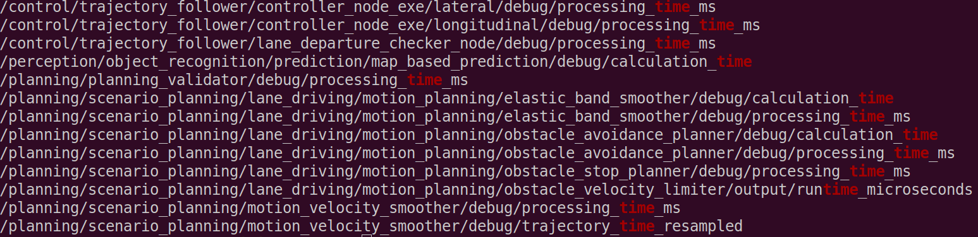
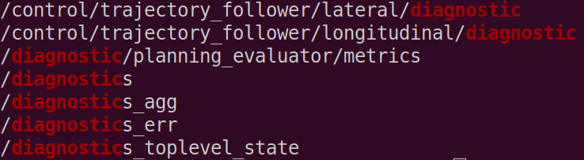
Topics
Lists of topics that’s monitored

Slide 5
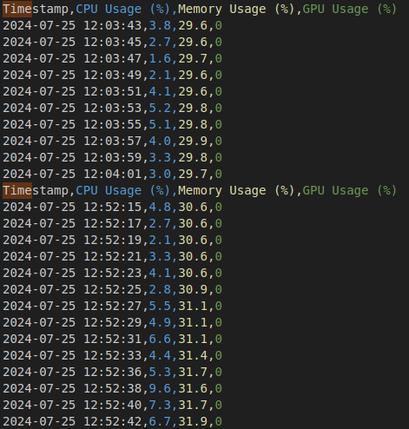
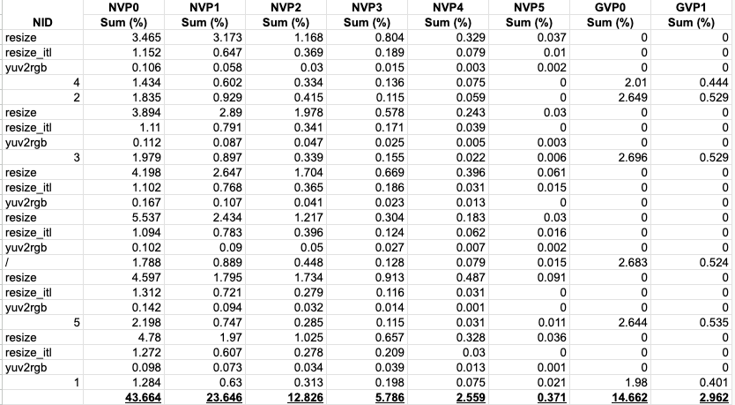
System Logging Results
Ambarella System Monitor
Nvidia Device System Monitor

Slide 6
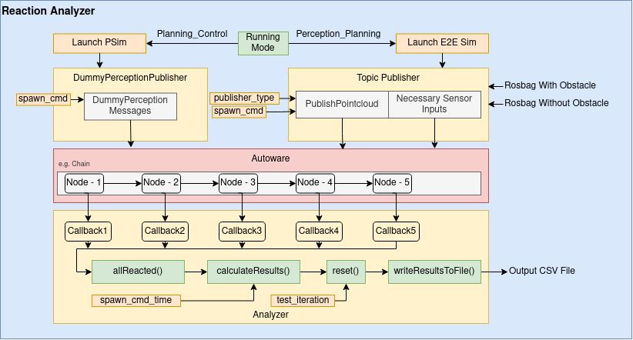
Review: Node Benchmarking
Reaction Analyzer
Subscribes to predetermined topics
Reports Node Latency, Pipeline Latency, and Total Latency for each of the nodes
https://github.com/autowarefoundation/autoware.universe/tree/main/tools/reaction_analyzer

Slide 7
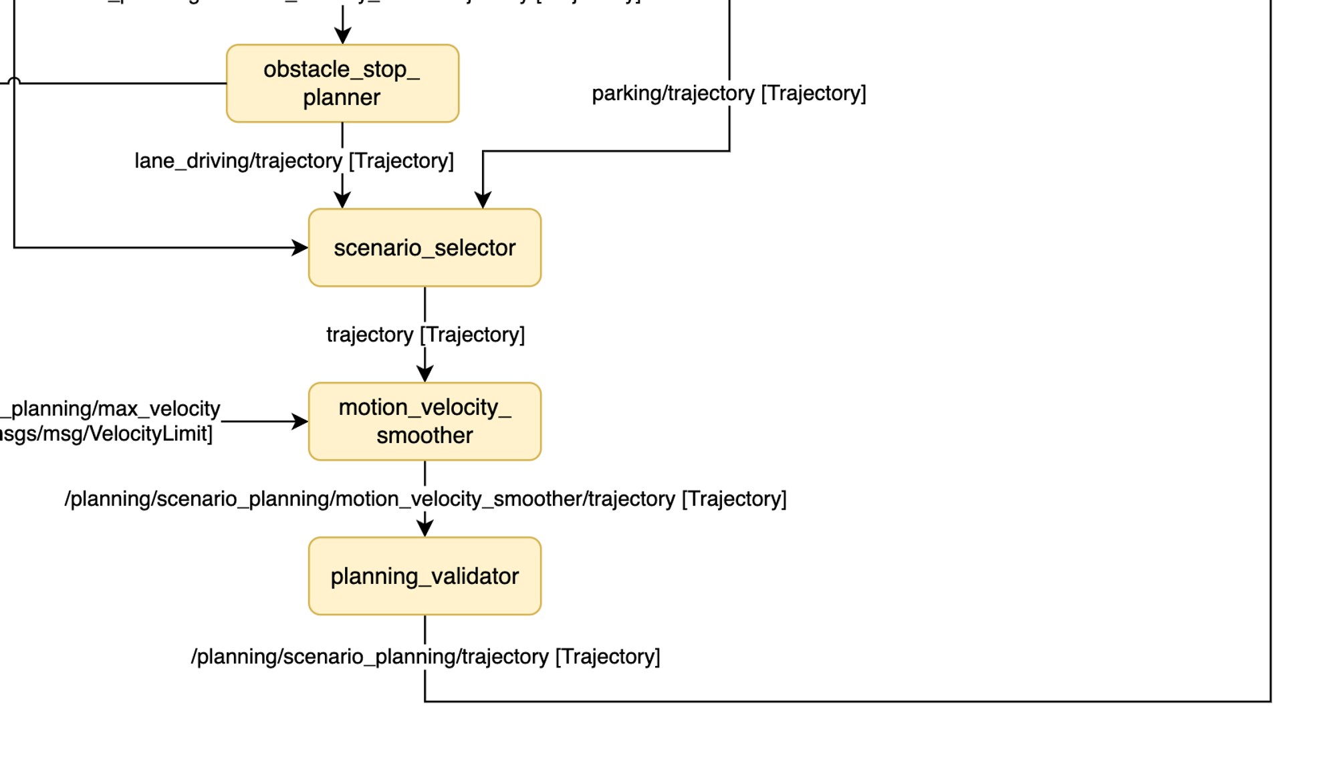
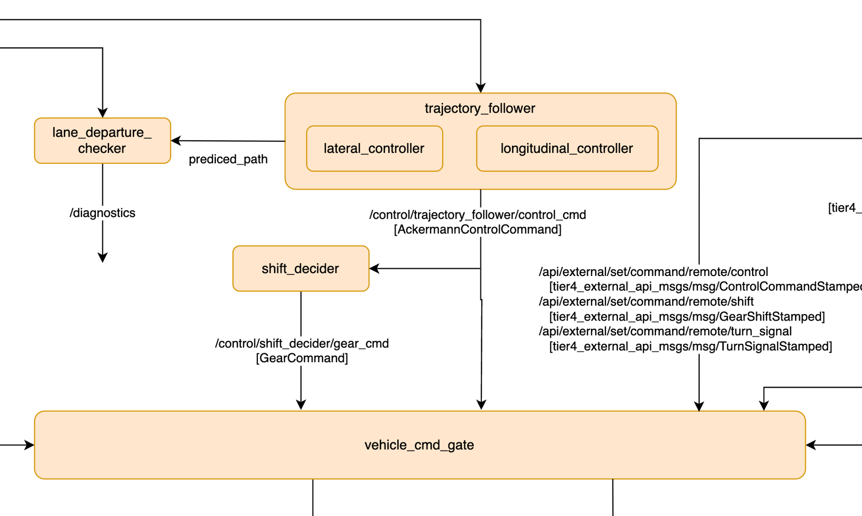
Reaction Time Analysis
Nodes monitored and pipeline flow

Slide 8
Reaction Analysis Nodes
Obstacle Cruise Planner
Controls planning (cruise/stop/slow down) based on detected obstacles
Scenario Selector
Parking/ Lane Driving/ etc.
Planning Validator
Checks validity of trajectory before publishing
4. Trajectory Follower
Generates control commands to follow a given Trajectory.
5. Vehicle Command Gate
Gets information from emergency handler, planning module, external controller, and send a msg to vehicle.

Slide 9
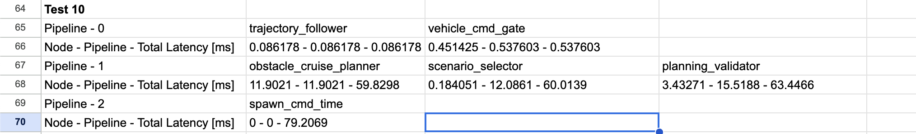
Reaction Time Results (Example)
Node Latency, Pipeline Latency, Total Latency

Slide 10
Ongoing Tasks
Using Reaction Analyzer: compatibility issues with current Autoware version, planning simulation, porting to Ambarella
Understanding Data: Node Latency, Pipeline Latency, Total Latency
Making sense of the topic outputs
Setting up a testing environment: A set of scenarios
2 Electrical Meter Sockets
https://www.amazon.com/gp/bestsellers/hi/6369370011/ref=zg_b_bs_6369370011_1

